Slide 1
Task guided taxonomy construction
Sanchita Badkas
2019H1030520P

Slide 2
Introduction
Task guided Taxonomy construction - A novel approach
Input : User provided seed taxonomy and domain specific corpus
Output : User specific application tasks taxonomy
Model is based on
Weakly supervised relationship extraction
Set expansion

Slide 3
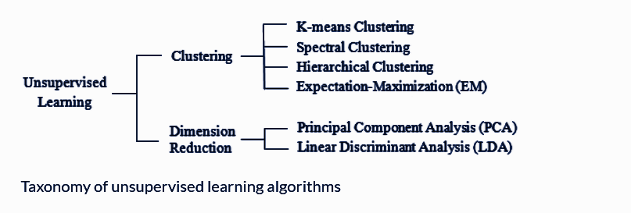
Taxonomy Construction:
Used for naming and classifying entities in a particular domain.

Slide 4
Approaches for TC:
Manual labour
Laborious and subjective
Bag of words
Clustering methodologies applied
Relationships ignored
Rule based
Leverage pattern based distributions like “Is-a” patterns
Variety in language makes difficult for covering all rules

Slide 5
Relationship Extraction:
Extracts semantic relationships from a given corpus/document.
Essential for extracting structured information from unstructured data.

Slide 6
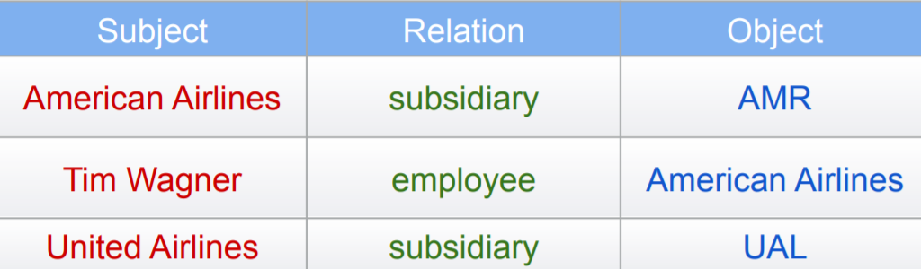
Relationship extraction
‘​CHICAGO (AP) — Citing high fuel prices, United Airlines said Friday it has increased fares by $6 per round trip on flights to some cities also served by lower-cost carriers. ​American Airlines, a unit of ​AMR, immediately matched the move, spokesman ​Tim Wagner ​said. ​United ​, ​a unit of UAL, said the increase took effect Thursday night and applies to most routes where it competes against discount carriers, such as Chicago to Dallas and Atlanta and Denver to San Francisco, Los Angeles and New York. ‘

Slide 7
Approaches for RE
Rule based RE
Supervised RE
Weakly supervised RE
Distantly supervised RE
Unsupervised RE

Slide 8
Approaches for RE
Rule based RE:
Extracting relations based on predefined rules.
E.g. “​USA is a country ​ ” here _ is a _ would be a rule.
Advantages : Simplicity and ease of extraction of relations for a specific domain
Drawbacks : Huge variety in language a lot of human labour is required for creating rules that would all the relations from a corpus. Thus, scaling this to corpus level is difficult.

Slide 9
Approaches for RE
Supervised RE:
Makes use of ML models like binary classifiers, NN to determine presence of relationship among entities.
Advantages : High recall scores
Drawbacks : Corpus needs to be preprocessed by NLP modules to extract features. Expensive to obtain labelled data for domain specific corpus

Slide 10
Approaches for RE
Weakly supervised RE:
Starts out with handful of seeds and iteratively finds new ones.
Advantages : Expensive labelled data isn’t required in large quantities.
Drawbacks :Seed intrusion errors can cause semantic drift if not monitored.
E.g. : ​Seed set - {iron, mercury, carbon} Here, mercury is a planet, element as well as Greek god.

Slide 11
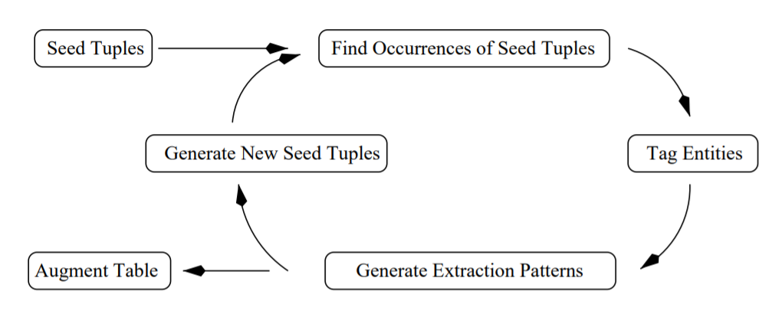
Approaches for RE
Weakly supervised RE:
The snowball method.

Slide 12
Approaches for RE
Distantly supervised RE:
Combination of Weakly supervised and supervised RE approaches. Seed set taken from existing knowledge bases like DBpedia, Yago and iteratively improved.
Advantages : Reduced effort in labelling data.
Drawbacks : Restricted to knowledge base. Also, prone to iterative errors while improving the seed set.

Slide 13
Approaches for RE
Unsupervised RE:
Uses heuristics and general rules for RE.
Advantages : Labelled data not required
Drawbacks : Completely dependent on heuristics

Slide 14
Weakly supervised RE:
Two different approaches:
Pattern based
Distribution based
Notes:
This is used to learn the textual pattern for relationship extraction. It predicts the relationship between an entity pair from multiple sentences who include both the entities. The traditional patterns extract the patterns in a bootstrapping manner. This method, however, faces difficulties during matching of the learned patterns to unseen context which leads to semantic drift. An e.g for the same is given in [3] as follows: Consider two sentences as, ● Beijing , the capital of China, is a megacity rich in history. ● Tokyo , Japan’s capital , was originally a small village .
Here, the pattern X the capital of Y is extracted easily. But, faces difficulty while extracting the same pattern in the second sentence due to the variety in the language

Slide 15
Weakly supervised RE
Pattern based approach:
Used to learn textual pattern for RE. Predicts relationship between entity pair from sentences including both entities.
Advantage : Simplicity.
Limitation : Faces difficulties during matching learned patterns to unseen context.
Beijing , the capital of China, is a megacity rich in history.
Tokyo , Japan’s capital , was originally a small village .
Here, the pattern X the capital of Y is extracted easily. But, faces difficulty while extracting the same pattern in the second sentence due to the variety in the language.

Slide 16
Weakly supervised RE
Distributional approach
Use the corpus level co-occurrence statistics of entities.
Focus on learning the low-dimensional representations to preserve these statistics which leads to entities having similar semantic meanings having similar representations.
Parameters like context type, frequency weighting, similarity measures used.

Slide 17
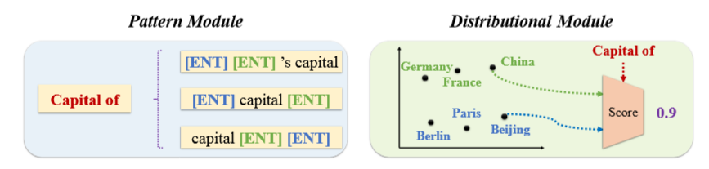
Weakly supervised RE

Slide 18
REPEL
REPEL - Relation Extraction with Pattern-enhanced Embedding Learning
Model works by combining the perspectives of pattern and distribution based approaches via co training.
Individually, supervision of these frameworks comes completely from initially provided instances. Instead, allow both models to supervise each other.
Pattern Module - Generator - Extracts candidate seed instances from corpus
Distributional Module - Discriminator - Evaluates each instance which serve as extra signals for generator to generate highly confident instances who would act as seeds from discriminator.

Slide 19
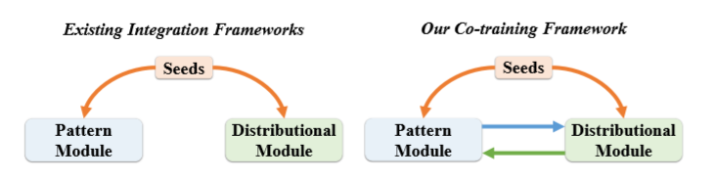
REPEL

Slide 20
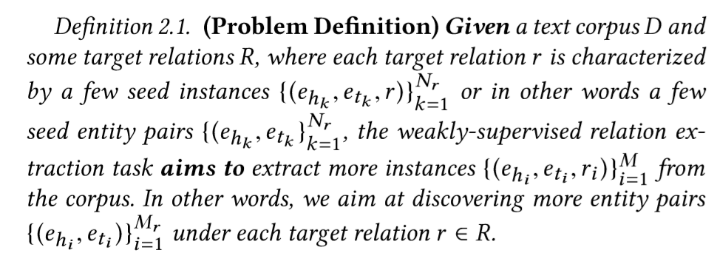
REPEL - Problem definition

Slide 21
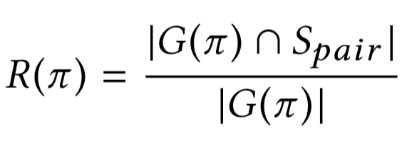
REPEL - Pattern Module
Π - Represents the patterns
R(π) -Represents the reliability of the p
G(π)- Represents all the entity pairs extracted by the pattern
S_{pair} - Represents the set of seed entity pairs under the target relation
If a pattern can extract many seed entity pairs under the target relation, then it will be considered reliable.

Slide 22
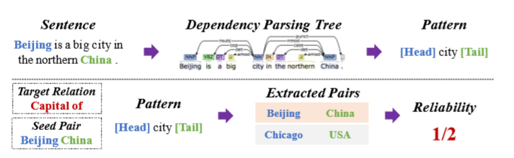
REPEL - Pattern Module

Slide 23
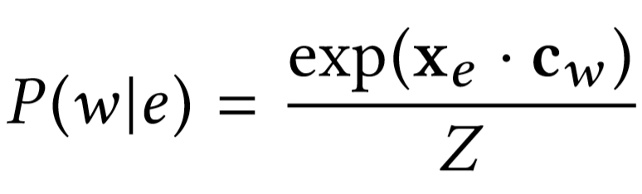
REPEL - Distributional Module
Build a bipartite network between all entities and words.
The weight between the entity and a word is defined as the number of sentences in which they co-occur. For an entity ‘e’ and a word ‘w’, the conditional probability is inferred as
x_{e} is the vector representation of entity
c_{w} is the embedding vector of word w
Z is the normalization
Both the functions of the modules are simplified to form objective functions which are optimized.

Slide 24
REPEL - Joint Optimization
Another objective function is introduced whose goal is to encourage the agreement of both the modules. This objective function is referred to as the joint optimization problem introduced in the paper.

Slide 25
Set Expansion
Process of expanding the original set of seeds.
Previous studies like Google Set, SEAL and Lyretail give good quality results but seed oriented online data extraction is costly.
Offline approaches are categorized into
One time entity ranking
Iterative pattern based bootstrapping​

Slide 26
Set Expansion - One time entity ranking
Assumes similar entities would appear in similar contexts
Make a one time ranking of candidate entities based on their distributional similarity with the seed entities.
Context required for the algorithms brought in by wikipedia lists and free text pattern and entity-entity distributional similarity is calculated based on all context features.
Limitation : Since all the contexts are used, high chances of seed intrusion error. Also, the extractions take place based on the initial seeds provided.

Slide 27
Set Expansion - Iterative pattern based bootstrapping​
Starts from seed entities and extracts quality patterns, based on a predeﬁned pattern scoring mechanism, and it then applies extracted patterns to obtain even higher quality entities using a different entity scoring method.
The process iteratively accumulates high quality patterns which are used for future iterations.
The quality of these patterns needs to be strictly maintained as seed intrusion problem can grow exponentially with each iteration causing semantic shift. Thus, the entity scoring methods are crucial and due to sensitivity towards the patterns, a huge amount of caution needs to be exercised.
Limitation : Having a perfect scoring mechanism is difficult due to diversity in the text data.

Slide 28
SetExpan - Novel framework
To address these challenges of previous approaches
To overcome the seed intrusion problem, it selects the context features based on distributional similarity instead of using all the available contexts.
To overcome the semantic drift problem, reset the feature pool at the beginning of each iteration. Makes use of an unsupervised ranking based ensemble method at each iteration to refine the entities.

Slide 29
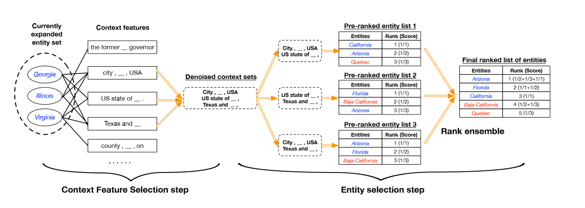
SetExpan - An iteration

Slide 30
SetExpan:
Data Model and Context Features
Context dependent similarity
Context feature selection
Entity selection via rank ensemble

Slide 31
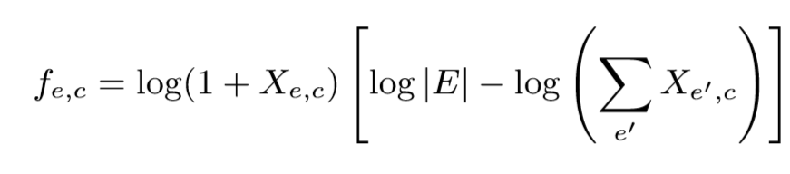
SetExpan - Data Model and Context features
Data is modeled as a bipartite graph, with candidate entities on one side and their context features on the other. These features are obtained using skip grams and coarse grained types.
Between each pair of entity ‘e’ and context feature ‘c’ weight is calculated using TD-IDF transformation.
X​e,c ​is the raw co-occurrence count between entity e and context feature c
|E| is the total number of candidate entities
Here, each entity e is treated as a “document” and each of its context feature c as a “term”.

Slide 32
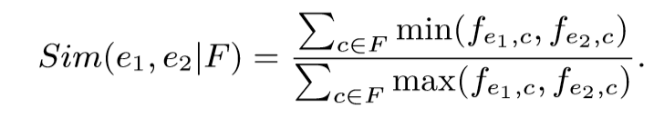
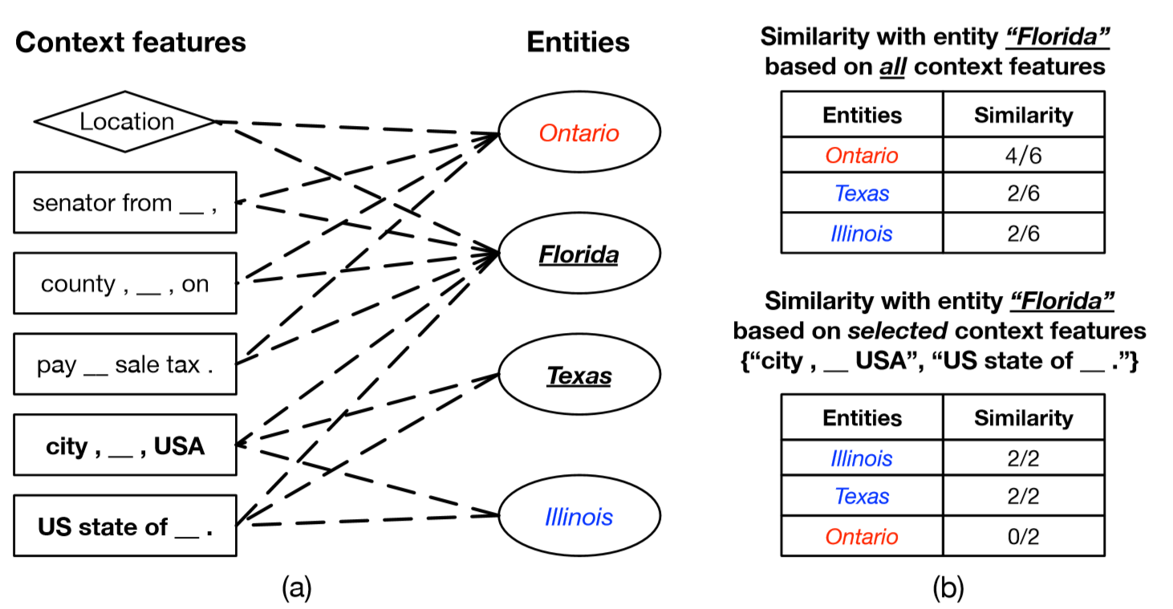
SetExpan - Context Dependent Similarity
To find the set of entities that are most similar to the current set. Weighted Jaccard similarity measure is used
Given a set of context features F, context-dependent similarity is calculated

Slide 33
SetExpan - Context Feature Selection
Helps ﬁnd a feature subset F​∗​ of ﬁxed size Q that best “proﬁles” the target semantic class.
Therefore, given such F​∗​, the entity-entity similarity conditioned on it can best reﬂect their distributional similarity with regard to the target class.
However, this is an NP hard problem. Thus, a heuristic method that ﬁrst scores each context feature based on its accumulated strength with entities in X and then selects top Q features with maximum scores is used.

Slide 34
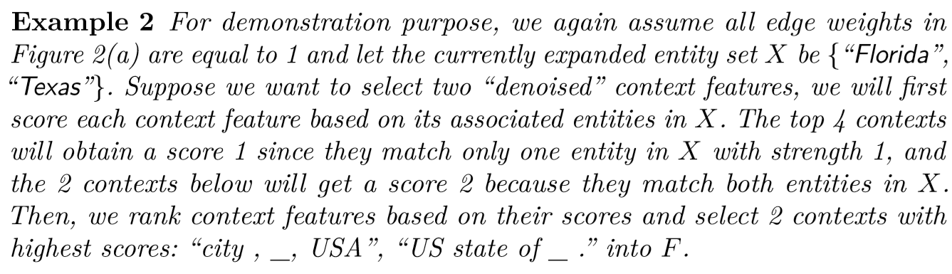
SetExpan - Context Feature Selection

Slide 35
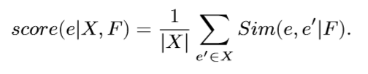
SetExpan - Entity selection via rank ensemble:
The algorithm ranks each candidate entity based on its score calculated by the following formula and then adds top-ranked ones into the expanded set.

Slide 36
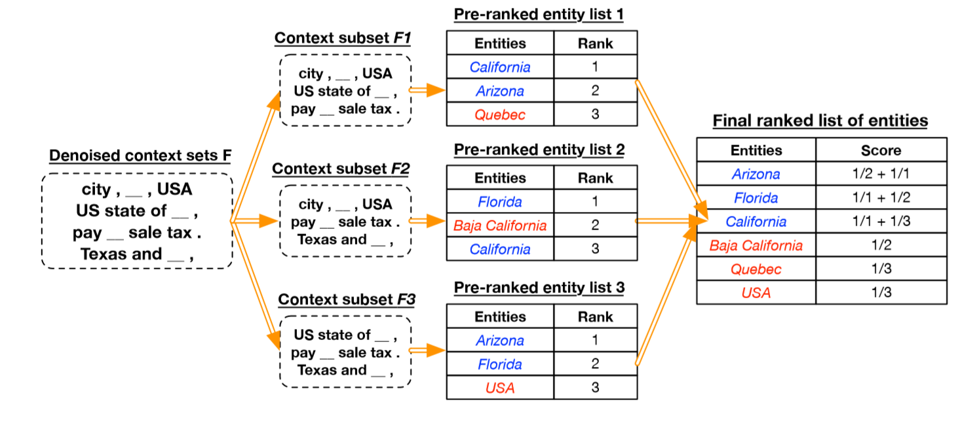
SetExpan - Entity selection via rank ensemble:

Slide 37
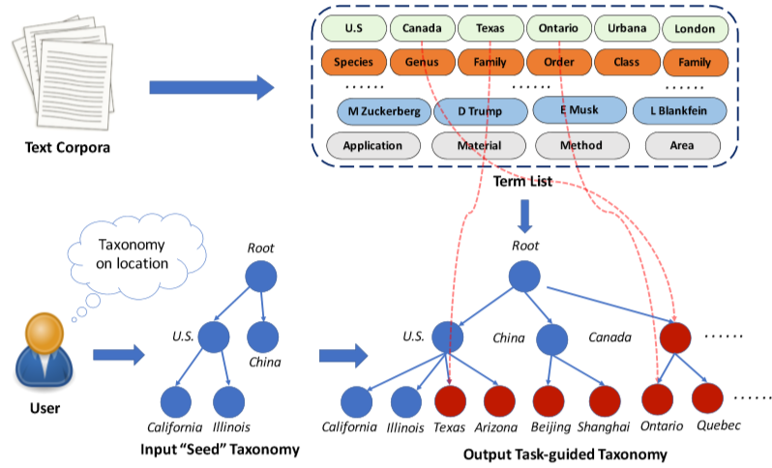
HiExpan Taxonomy Constructor:
Uses SetExpan - Horizontal Expansion
Uses REPEL - Vertical Expansion

Slide 38
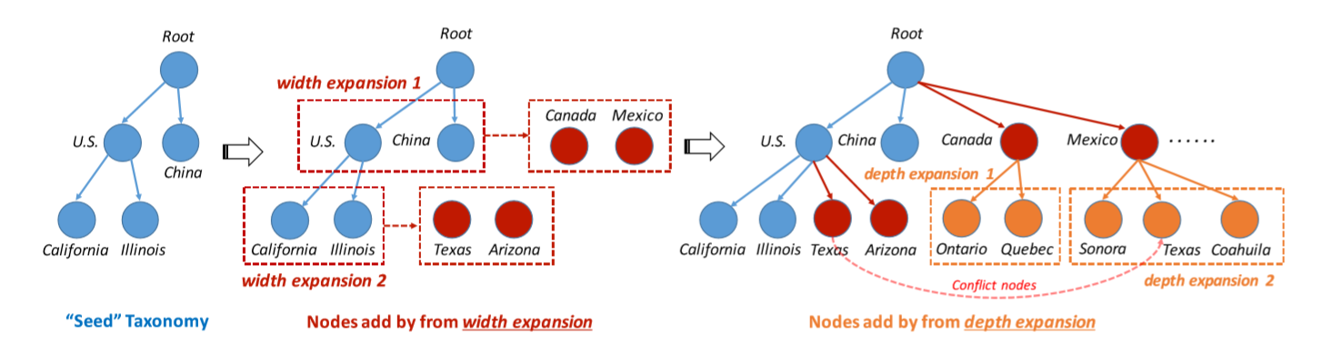
HiExpan Taxonomy Constructor:

Slide 39
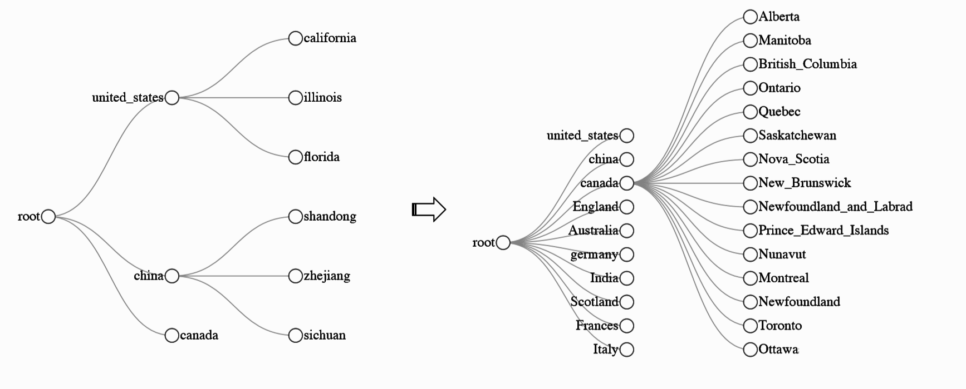
HiExpan - Results on WikiList

Slide 40
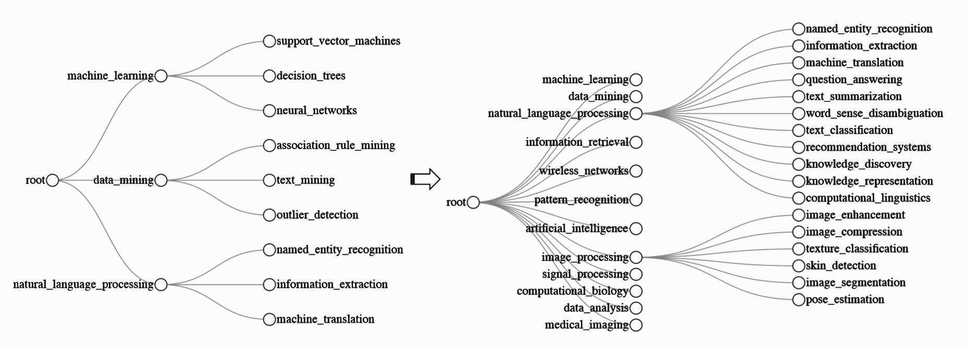
HiExpan - Results on DBLP

Slide 41
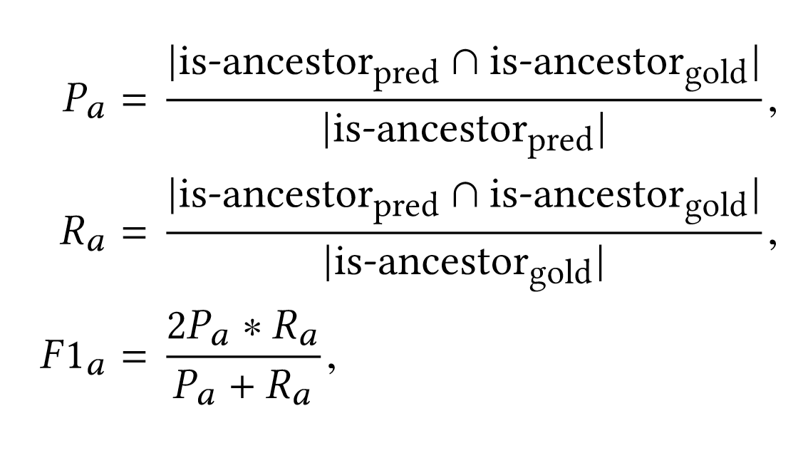
HiExpan - Quantitative Results:
The quantitative results included P​a​, R​a​, F1​a​ denote the ancestor-Precision, ancestor-Recall, and ancestor-F1-score, respectively. Similarly, edge-based metrics are P​e​,R​e​,and F1​e,​respectively.

Slide 42
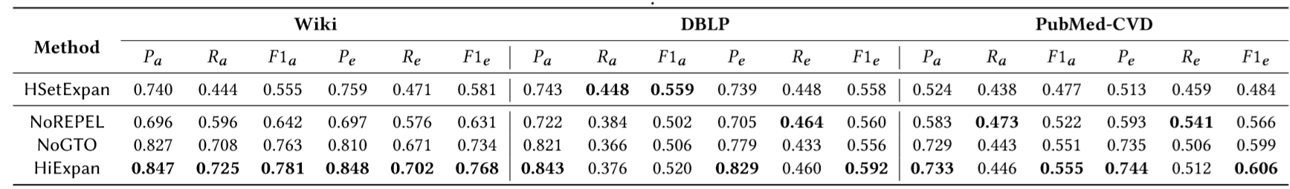
HiExpan - Quantitative Results:
1. HSetExpan - Iteratively applies SetExpan at each level of taxonomy. For lower levels it uses the child-parent similarity for deciding the best parent to attach the node.
2. NoREPEL - The HiExpan algorithm without the REPEL module. It instead uses a skip gram model for learning term embeddings.
3. NoGTO - HiExpan algorithm without the optimization module.
4. HiExpan - The proposed framework

Slide 43
What can be improved?
Problems:
HiExpan tends to place synonyms at the same level of taxonomy as they share the semantic meanings and appear in similar contexts. These synonyms tend to make the generated taxonomy less informative, reducing the overall quality.
Domain specific corpus needs to be available for input.
Difficult with new domains coming in frequently
Corpus for domain widely available compared to corpus for subdomain causing problem in case of constructing a taxonomy of a subdomain.
Choice of seeds is subjective

Slide 44
What can be improved?
Solutions:
Need to incorporate “Knowledge + Context” in taxonomy construction. A hierarchical clustering approach for this has been proposed by Microsoft.
To remove the subjectivity of the seeds, need to filter them by removing ,
Prototypicality - Words which are most representative of a domain. The high frequency of these words includes a lot of variety in contexts which may cause semantic drift in the generated tree.
Ambiguity - Polysemy of seed can introduce seed intrusion in the taxonomy. This can be avoided by providing a domain specific corpus like in the case of HiExpan, but when it isn’t available this ambiguity needs to be removed.
Coverage - Coverage of a seed set for a concept is the amount of semantic space which the seed shares in common with the semantic space defined by the concept.

Slide 45
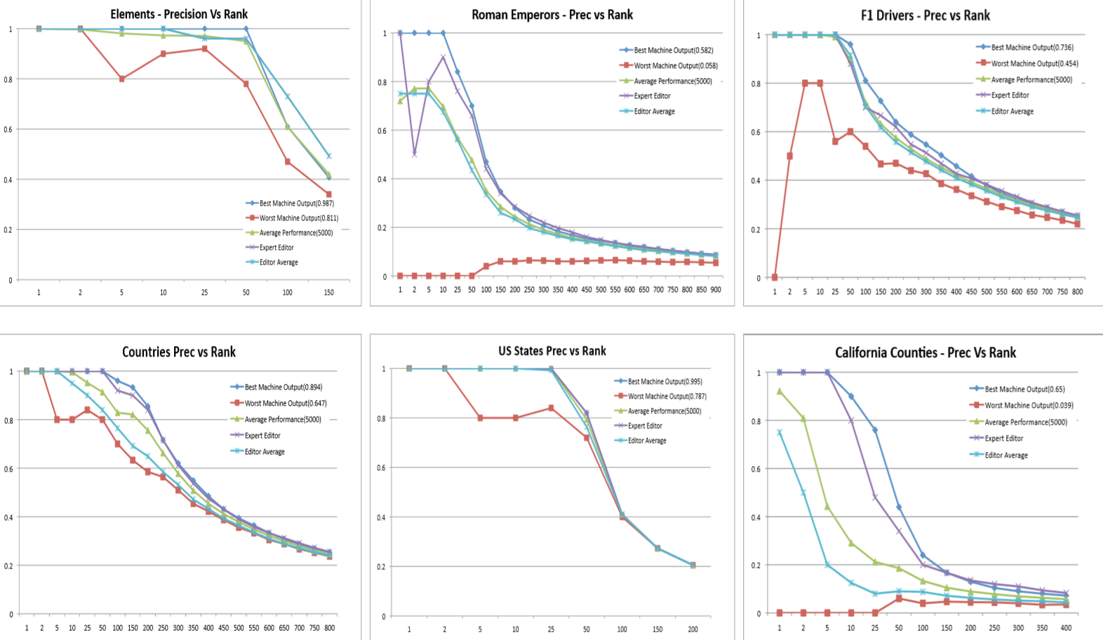
Effect of choice of seeds:

Slide 46
Thank you!

